Slide 1

SHARDA UNIVERSITY UZBEKISTAN
WELCOME TO
Sharda University Scholarship-Admission Test
SUSAT-2020

Slide 2
Examination Process:
#1: SUSAT-2020 (ONLINE MODE)
#2: Personal Interview (ONLINE MODE) / IELTS
Note:
A) PI session will be conducted on ZOOM or via IMO with those who do not have a valid IELTS Score.
B)Candidates who are holding a Valid IELTS Certificate[Min: 5 Band IELTS Score] do not take PI session.

Slide 3
SUSAT ENTRANCE EXAMINATION-2020
GENERAL INSTRUCTIONS

Slide 4


Steps To Start your Exam
Step 1: Use any Web browser from the following options :
Don’t use Internet Explorer :

Slide 5
Steps To Start your Exam
Step 2: After that type the following link:
https://quizbyte.sharda.ac.in/index.php/login

Slide 6
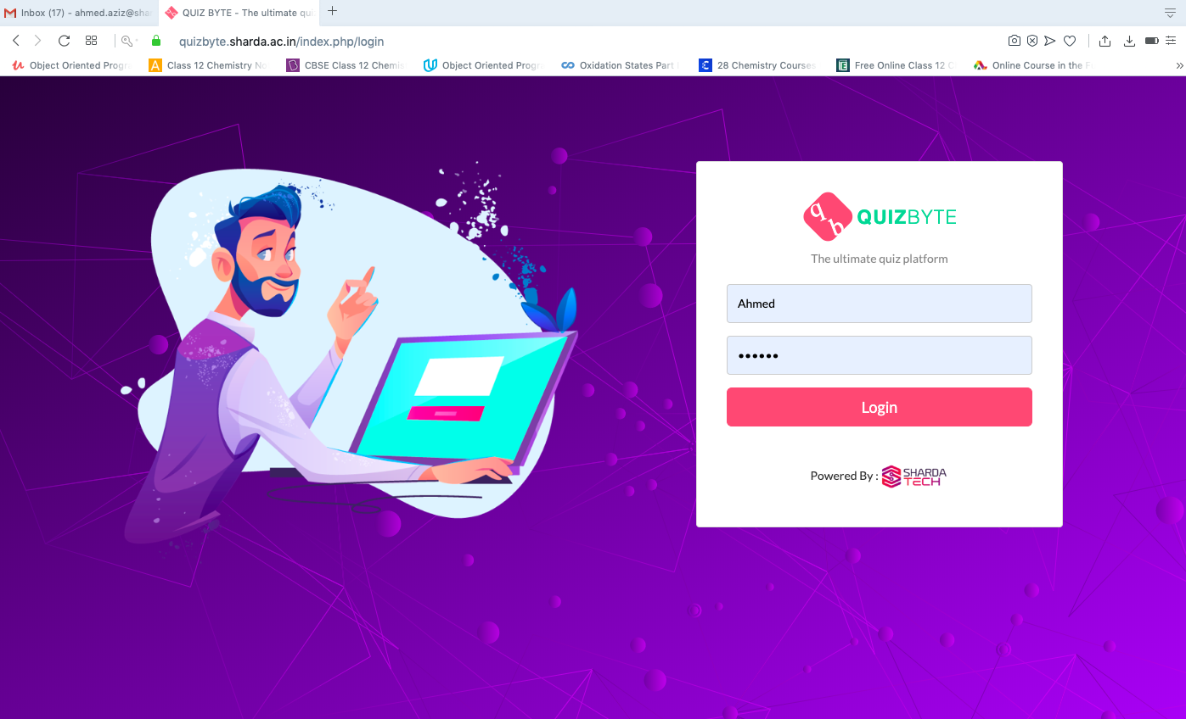
Steps To Start your Exam
Step 3: Enter your Username and Password

Slide 7
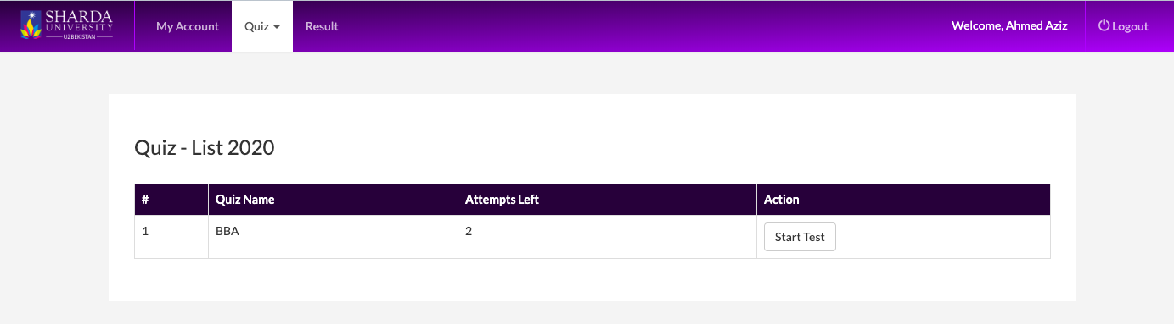
Steps To Start your Exam
Step 4: Ensure that your name is correctly written on the exam page

Slide 8
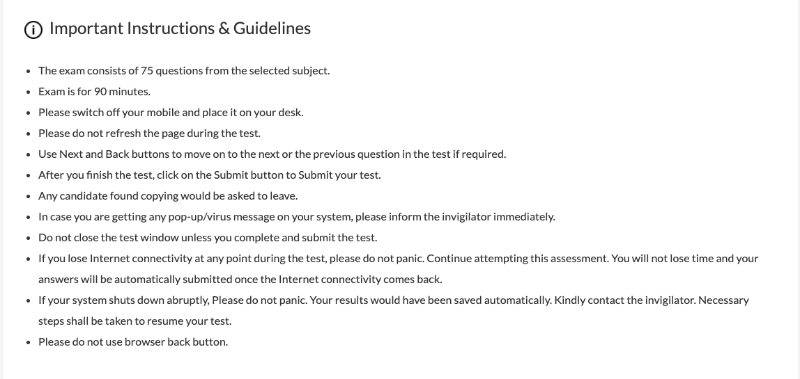
Steps To Start your Exam
Step 5: Read the Instruction Carefully:

Slide 9
Steps To Start your Exam
Step 6: After Reading the instructions Press “Start Test Button”

Slide 10
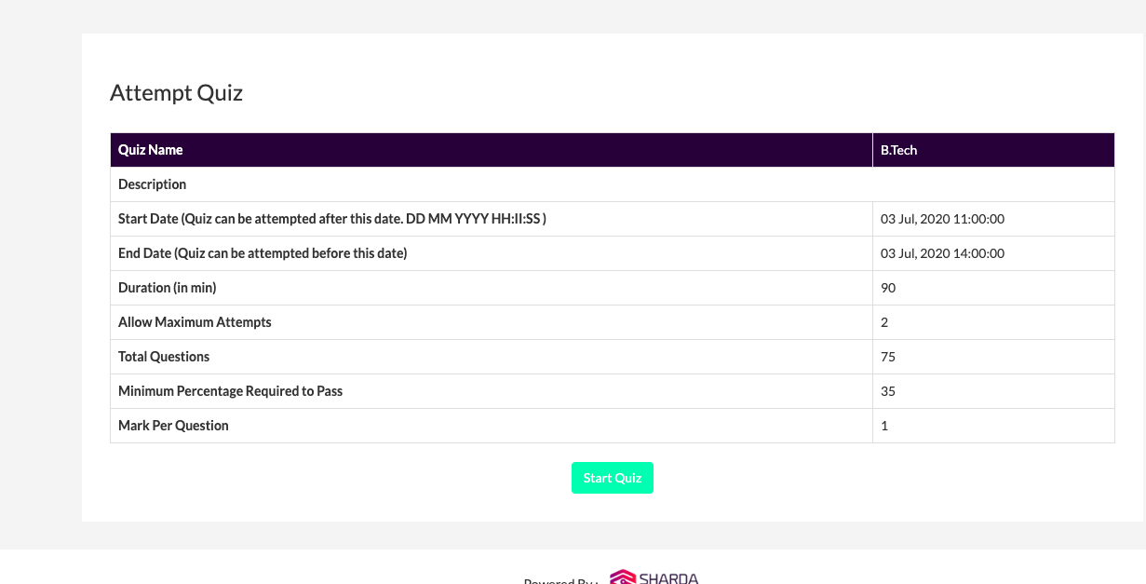
Steps To Start your Exam
Step 7: Press “Start Quiz Button”

Slide 11
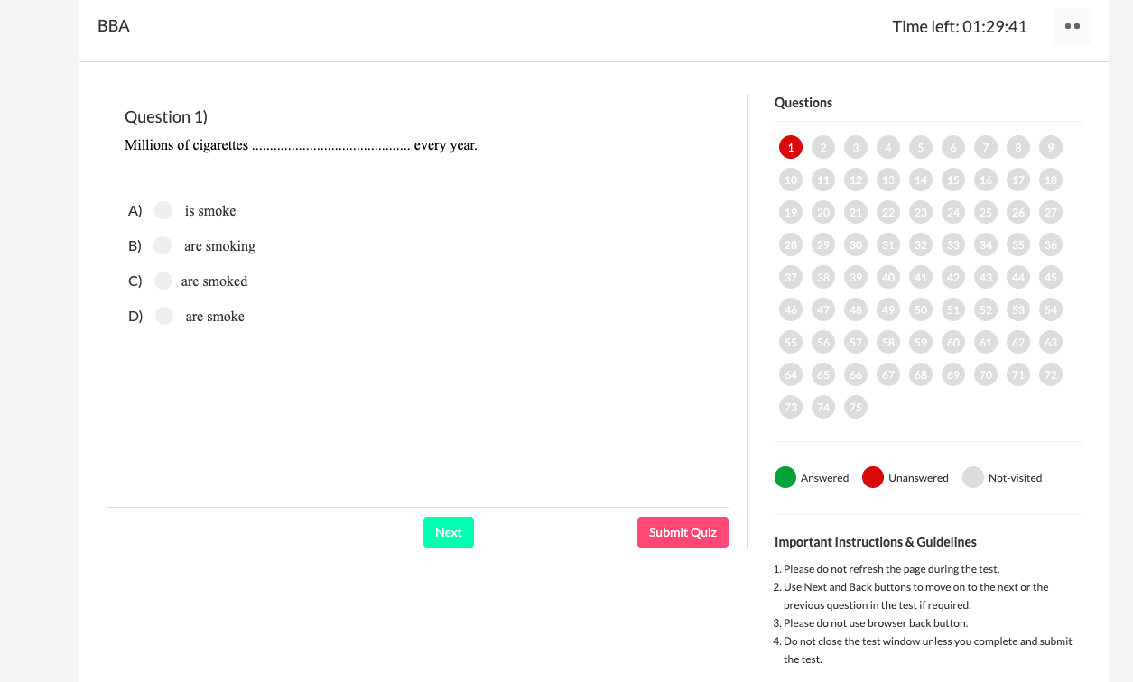
Steps To Start your Exam
Step 8: Overall you have 75 questions as shown on the right side. On the left side you will find the select question. For example as shown in the below image I select question no 1 so that on the right side its red and on the left side the question is shown.

Slide 12
Steps To Start your Exam
Step 9: on the right side if the button is red its means that you still not answered the question and if your answer it will become green.
Important Note:
* Green not mean correct answer and red not mean Wrong answer it only indicate if you answer the question or not

Slide 13
Steps To Start your Exam
Step 10: After reading the question you can select any options as your answer by click on the available answer options under the question

Slide 14
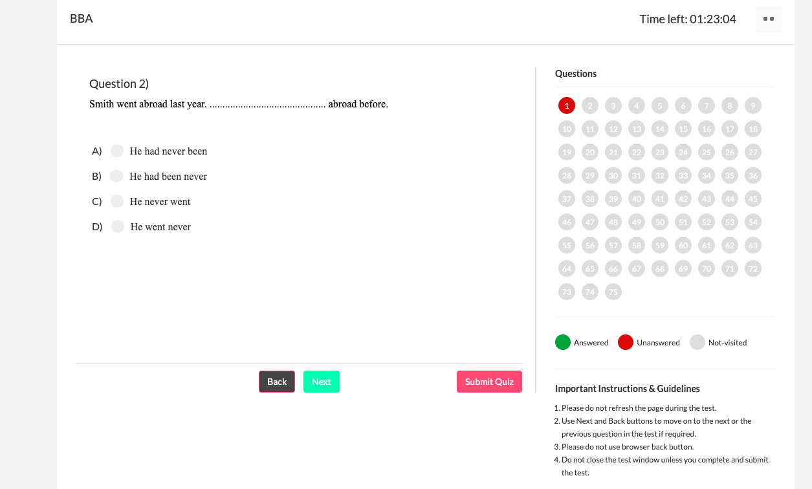
Steps To Start your Exam
Step 11: After selecting your answer press Next Button to go to the next Question

Slide 15
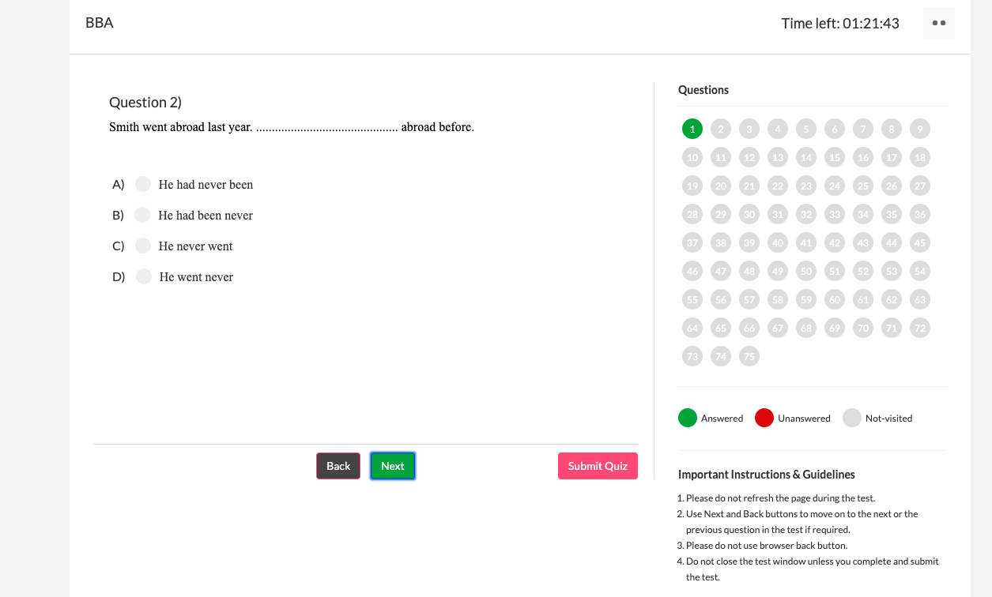
Steps To Start your Exam
Step 12: If you want to go back for the previous question by Pressing “Back Button”

Slide 16
Steps To Start your Exam
Step 13: You can swap between the questions by clicking on the question numbers on the right side

Slide 17
Steps To Start your Exam
Step 14: Anytime you want to submit your answers you can press” Submit Quiz Button”

Slide 18
Steps To Start your Exam
Step 15: Time is shown on the most top of the right side. Please note that you have only 1:30 hours to submit your answer. Otherwise, the exam will be closed automatically after the time is over.

Slide 19
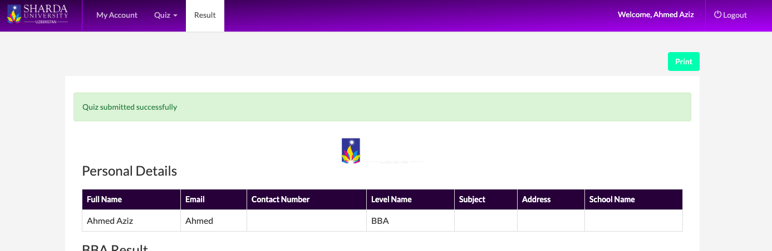
Steps To Start your Exam
Step 16: Now you are successfully Done your SUSAT and now press “Logout Button ”, and
Go For Personal Interview if you do not have an IELTS Score

Slide 20

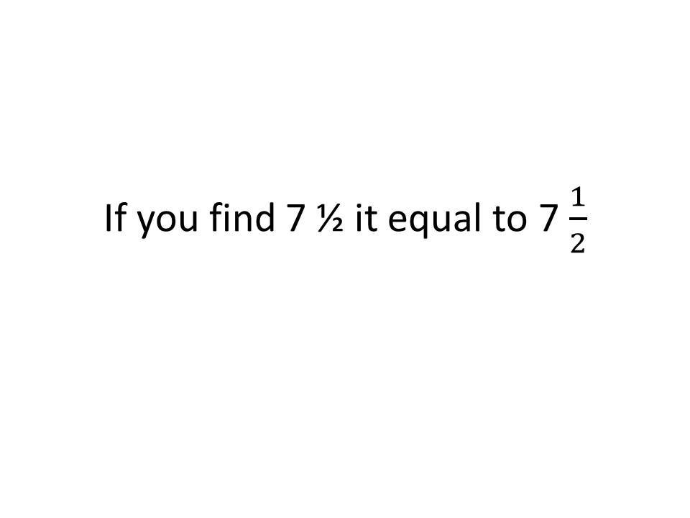
Important Notice

Slide 21
PERSONAL INTERVIEW SESSION-2020
GENERAL INSTRUCTIONS

Slide 22
#2: PERSONAL INTERVIEW SESSION
Steps To Start your Exam
Download and install ZOOM application
Installation – Zoom Help Center
or
Download and install IMO application
https://play.google.com/store/apps/details?id=com.imo.android.imoim&hl=en
NOTE:
If it is not reachable to you on ZOOM, PI session will be conducted via IMO!

Slide 23
For Any Query,
Please Feel Free to call:
+998 90 5251234 Mr. Abdiqunduz
+998 90 5261234 Mr. Shokirjon
+998 90 5271234 Mr. Nurislom
+998 90 5281234 Mr. Nodirbek
+998 90 5291234 Ms. Mushtariy

Slide 24
Thanks for your attention

